Slide 1
UK HOUSING MARKET
David, Seerat, Hamza, Sarah

Slide 2
INTRODUCTION
We investigated property trends and if market conditions effect the property market. We analysed the average prices of different property types and the sales volumes of new builds vs existing properties. Also, we examined the inflation and interest rates since 2007.

Slide 3





CONTENTS
Introduction
Property Types
New Builds vs Existing Properties
Cash Purchases vs Mortgages
Market Observations
Overall

Slide 4

Property Types
Semi-Detached
Detached
Flat
Terraced

Slide 5
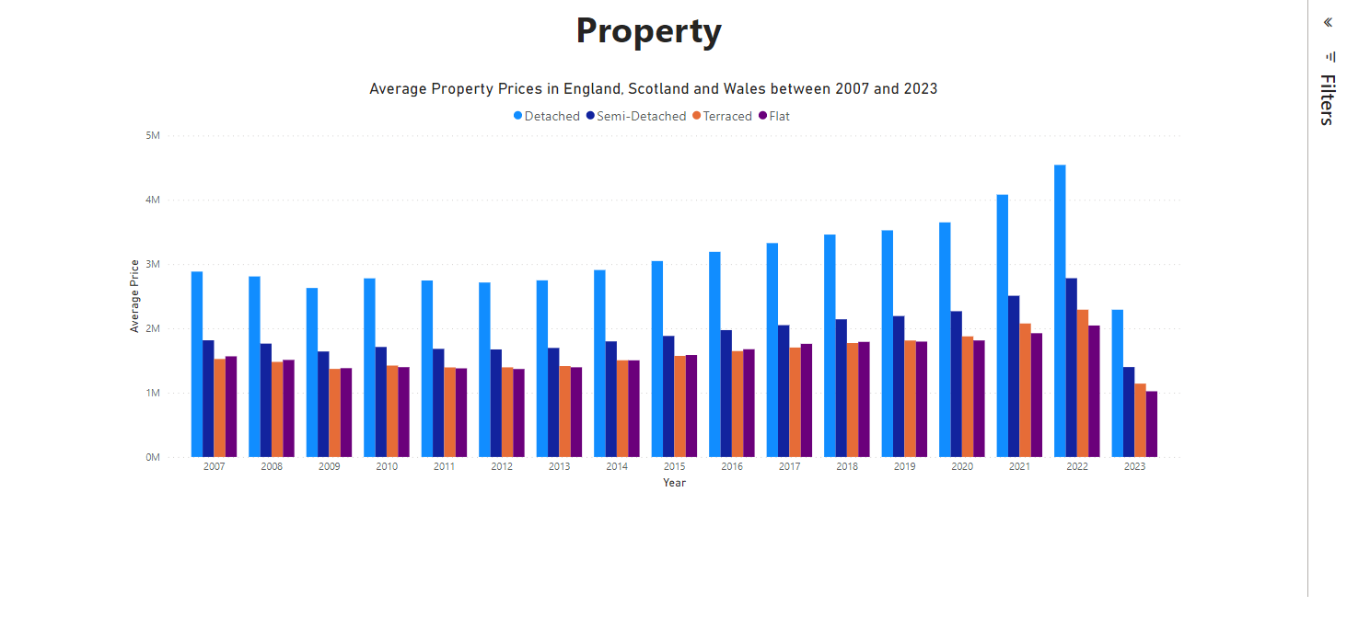

Slide 6
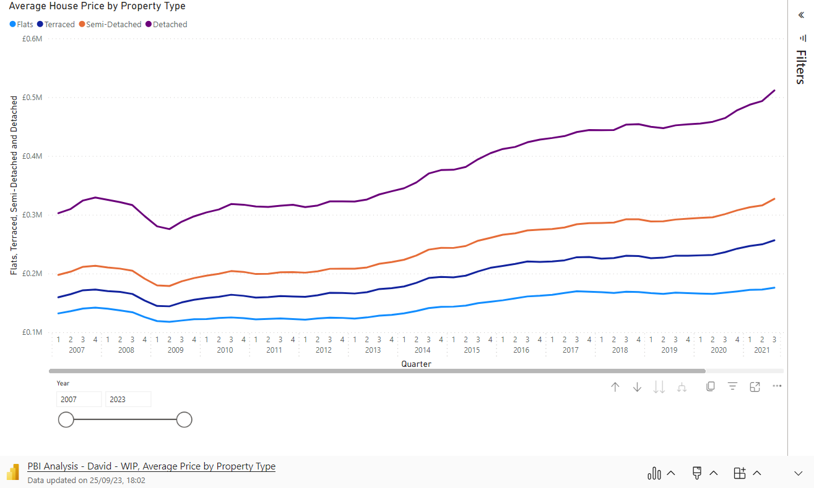

Slide 7
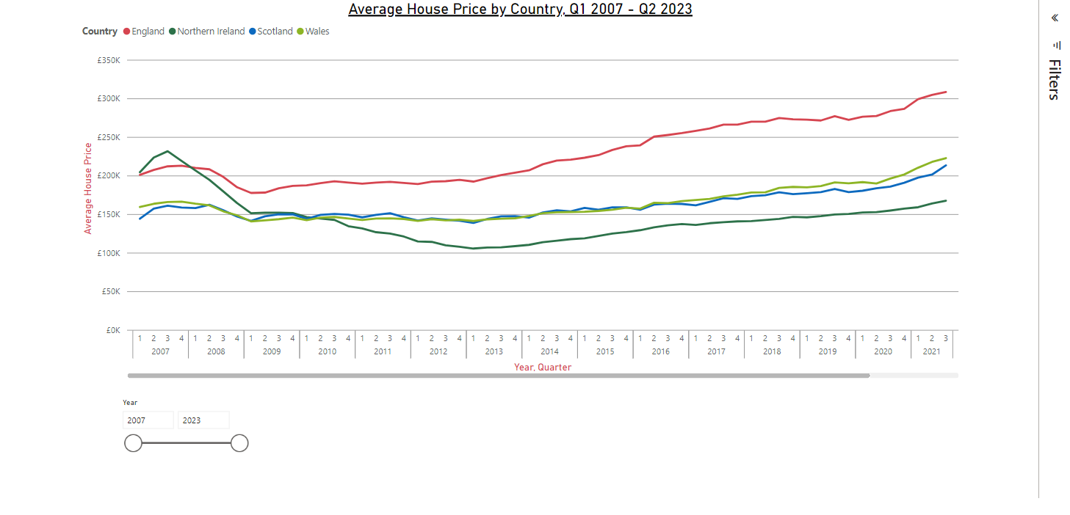

Slide 8
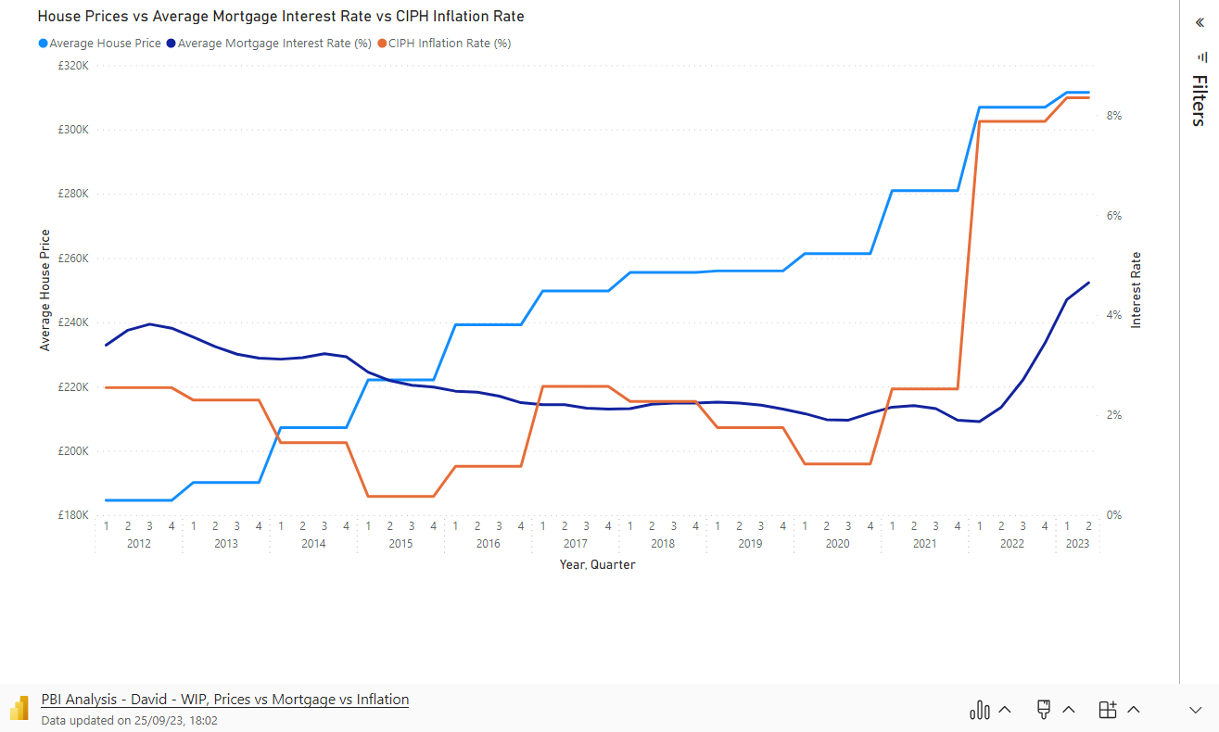

Slide 9
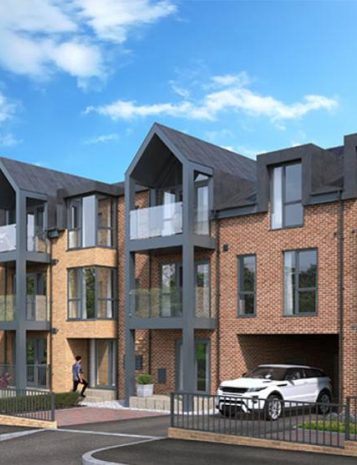
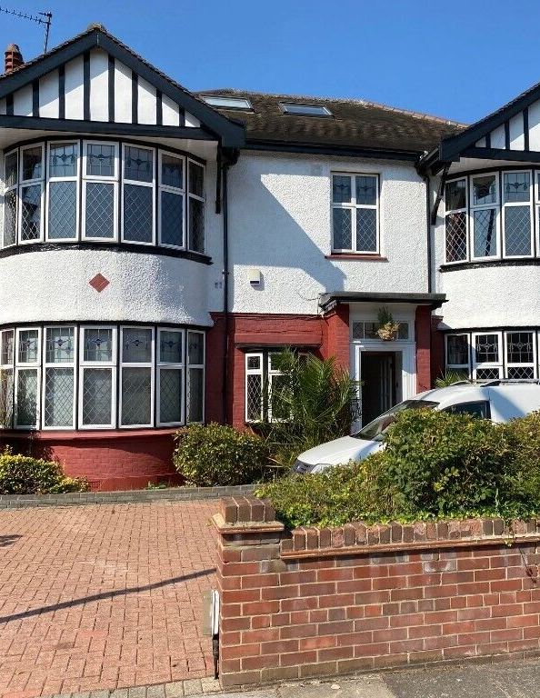

NEW BUILDS VS EXISTING PROPERTIES

Slide 10
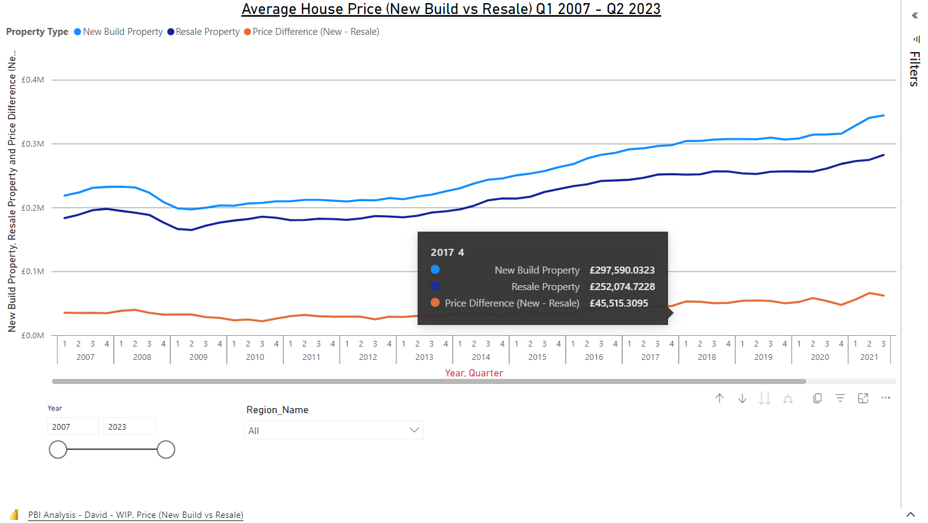

Slide 11
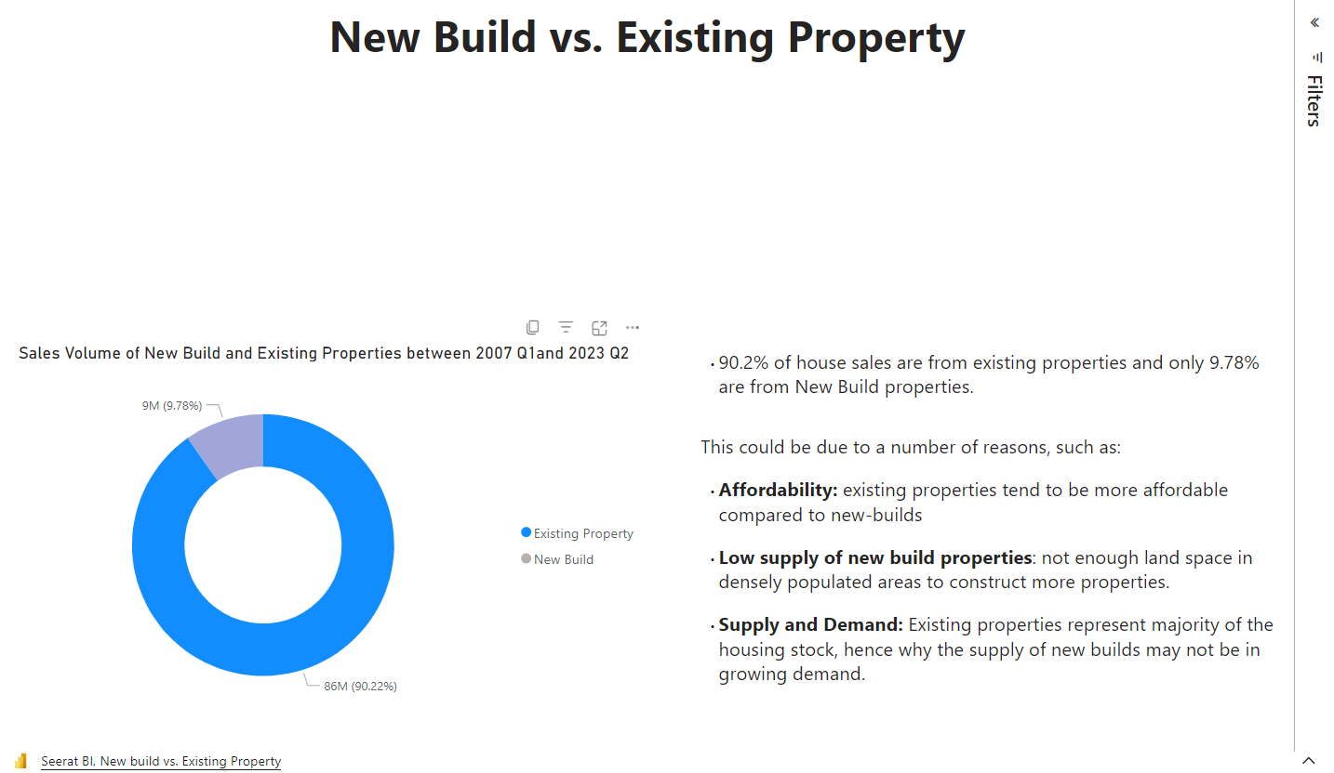

Slide 12

CASH PURCHASES & Mortgages

Slide 13
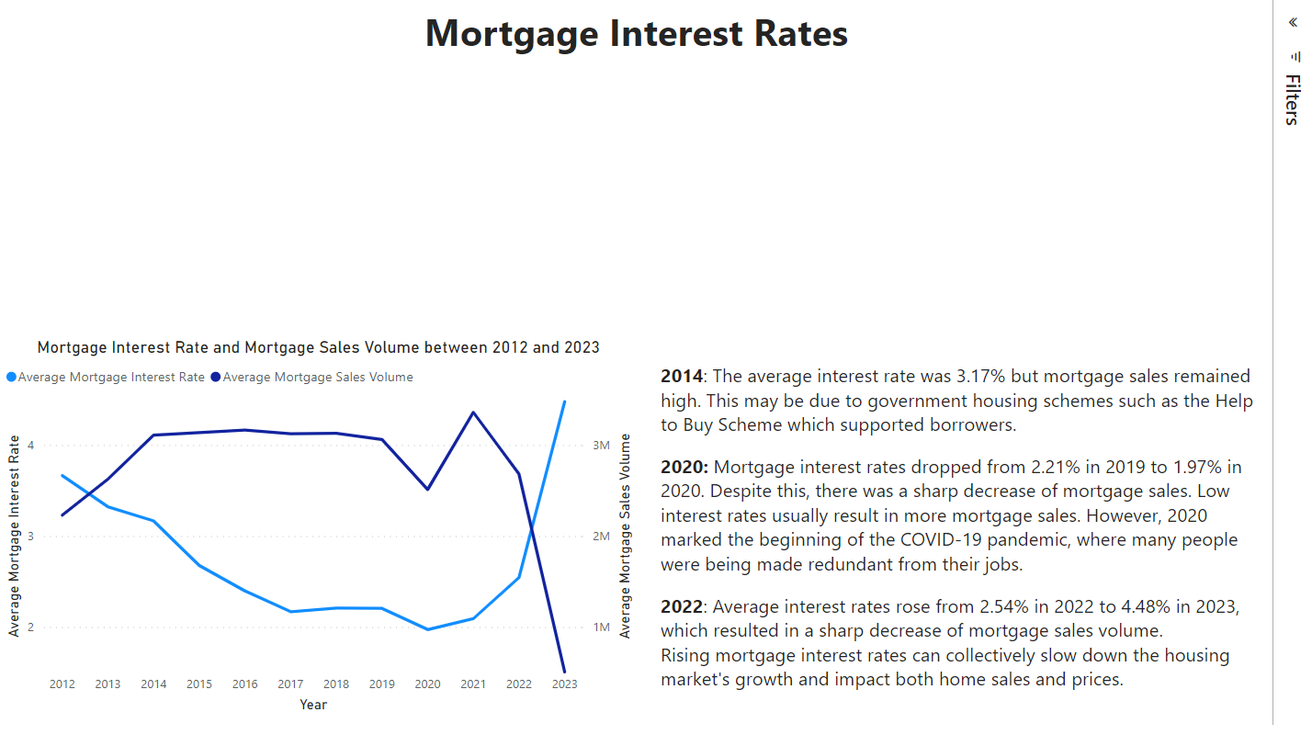

Slide 14
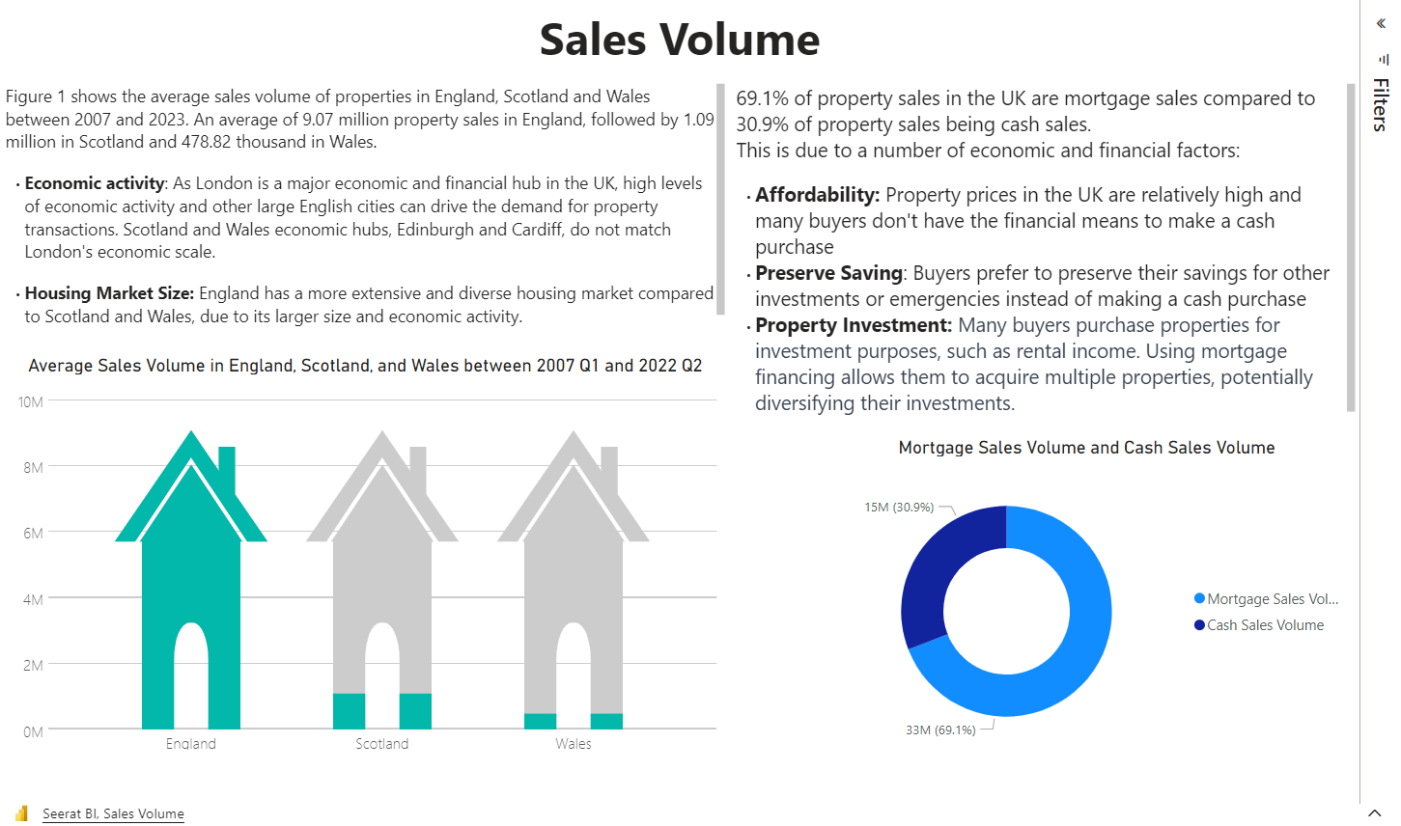

Slide 15
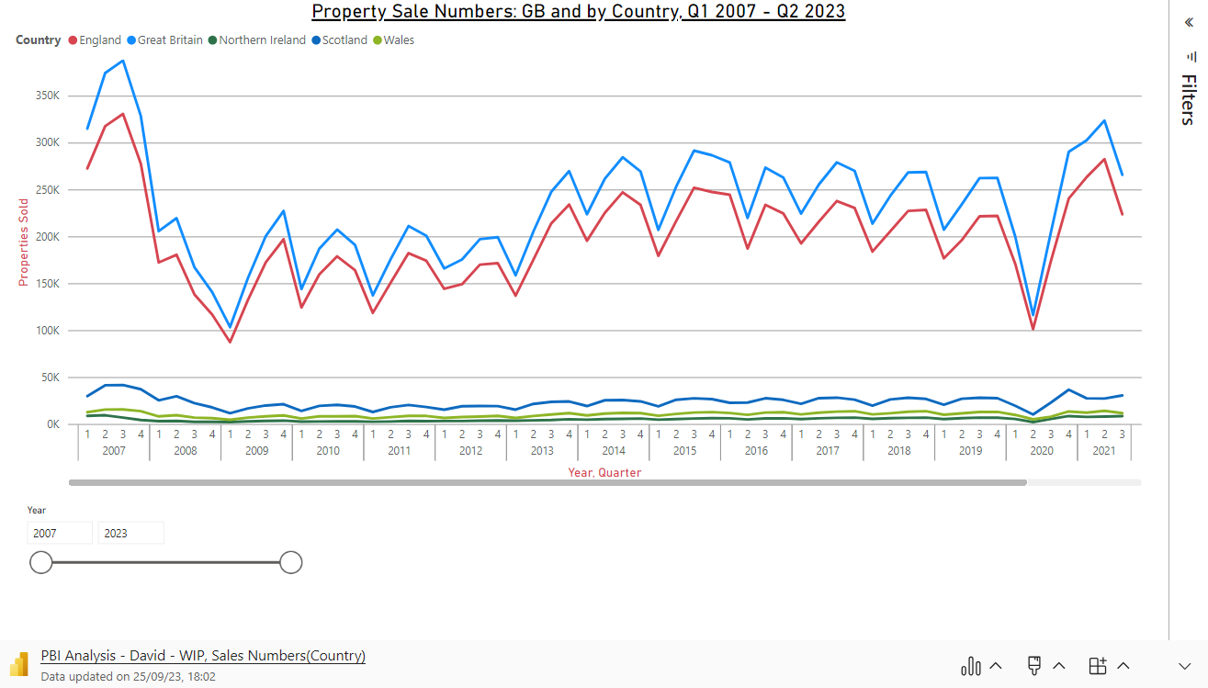

Slide 16
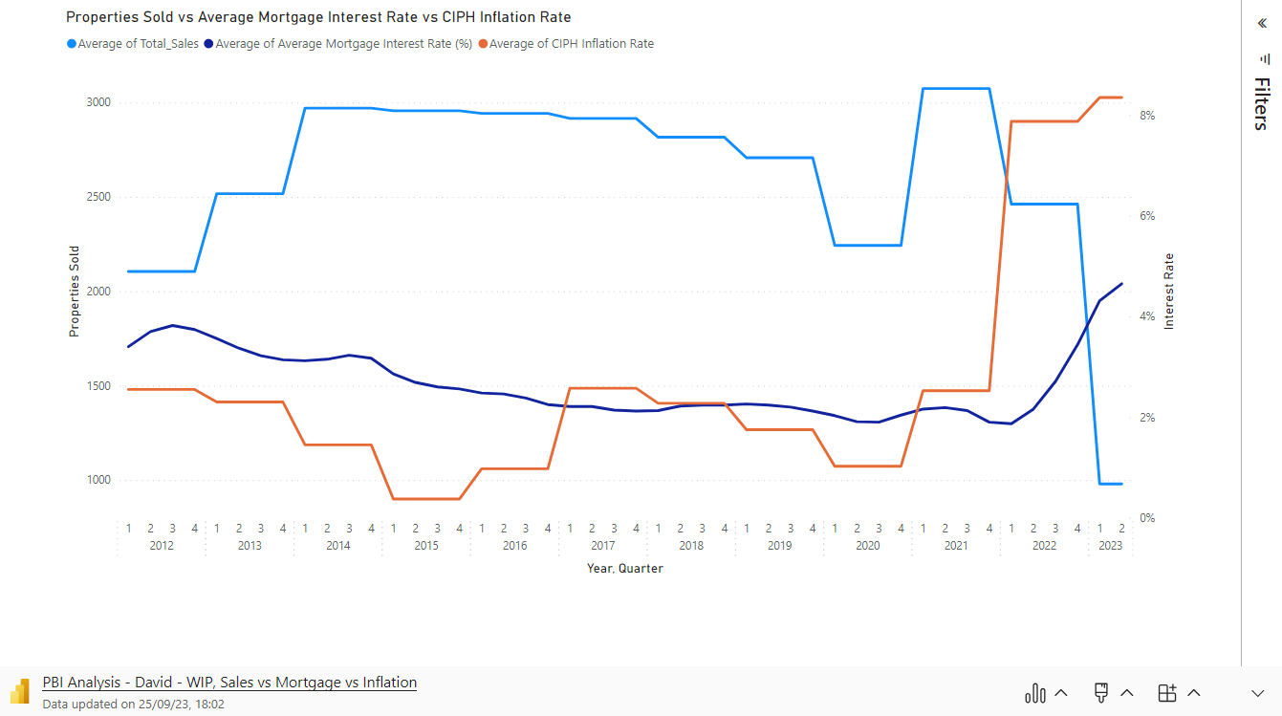

Slide 17
MARKET OBSERVATIONS

Slide 18




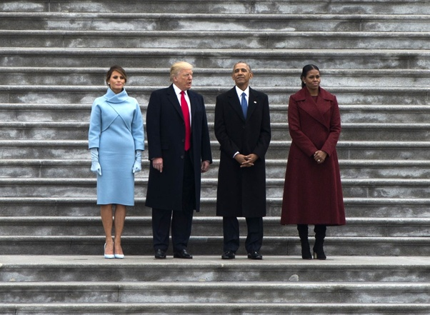



Property Market Timeline
2008
2010
2013
2014
Sept: Stamp Duty was increased to £175,000.
Stamp duty holiday for first-time homebuyers up to £250,000.
April 13: Help to Buy Equity Loan Scheme for England and Scotland.
Jan 14: Help to Buy Mortgage Guarantee Scheme in England.
2016
2018
2020
2021
Dec 16: The Help to Buy ISA scheme
"First Homes" scheme in England
Stamp duty holiday on properties up to £500,000
A new 95% mortgage guarantee scheme.
The Help to Buy Equity Loan scheme in England.

Slide 19
SUMMARY

Slide 20
THANK YOU

Slide 21
https://www.sanctuary-homes.co.uk/sites/default/files/styles/3_by_2/public/quick_media/the-westcliffs-cgi-resized1.jpg?itok=JgTS-g9u&c=2f757153de64582d29725940d23b3a43

